Slide 1
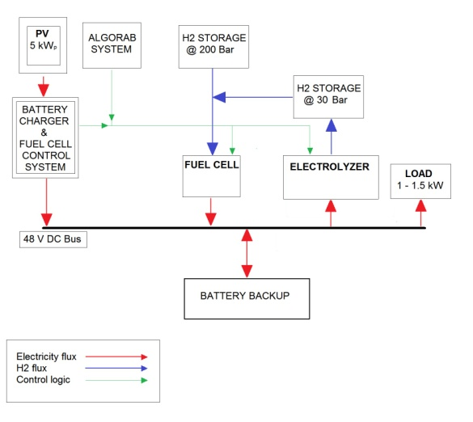
Layout of the FC-powered RBS system

Slide 2
Schematic of the laboratory setup implemented at the University of Rome Tor Vergata.

Slide 3
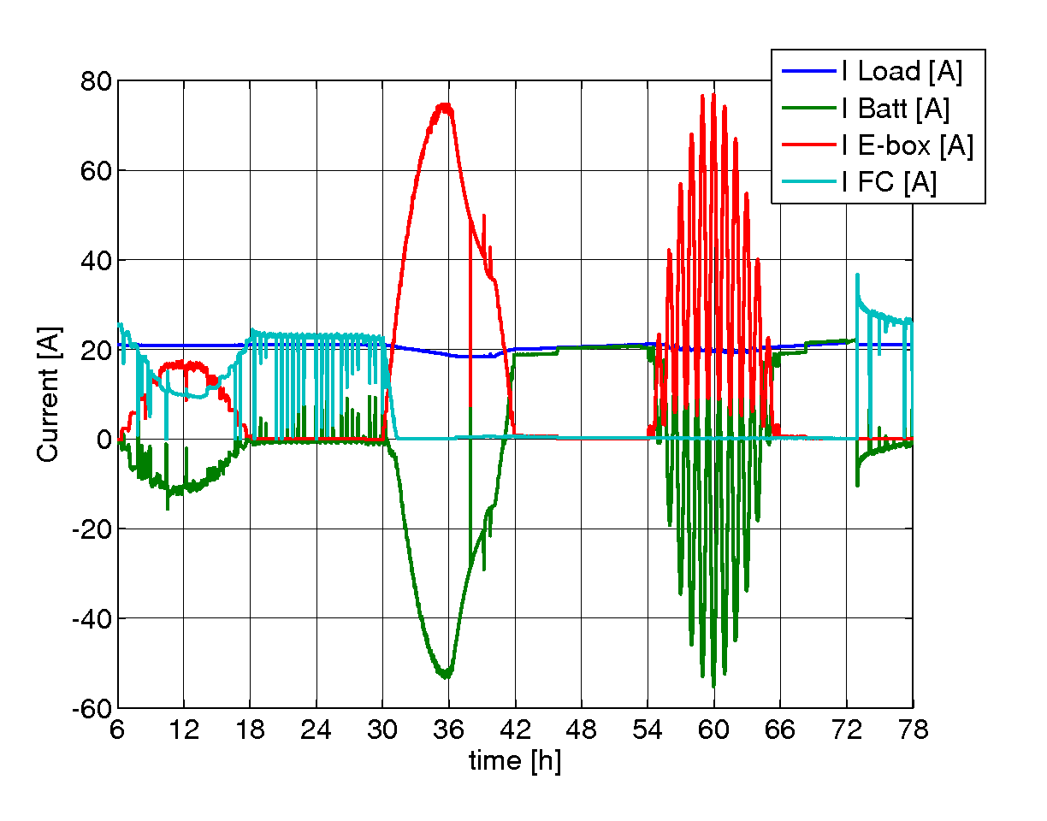
Evolution of current output of the different components, during the 72h benchmark test. Dantherm system w/o electrolyzer.

Slide 4
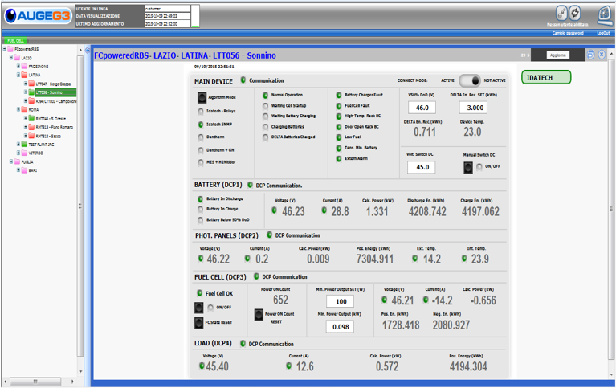
Smart metering solution

Slide 5
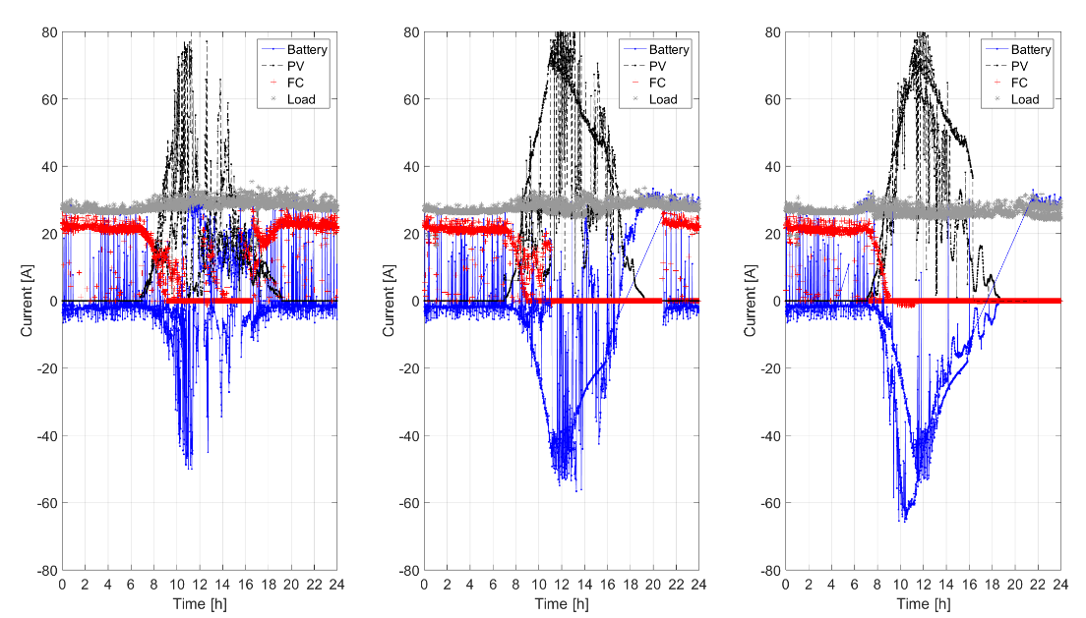
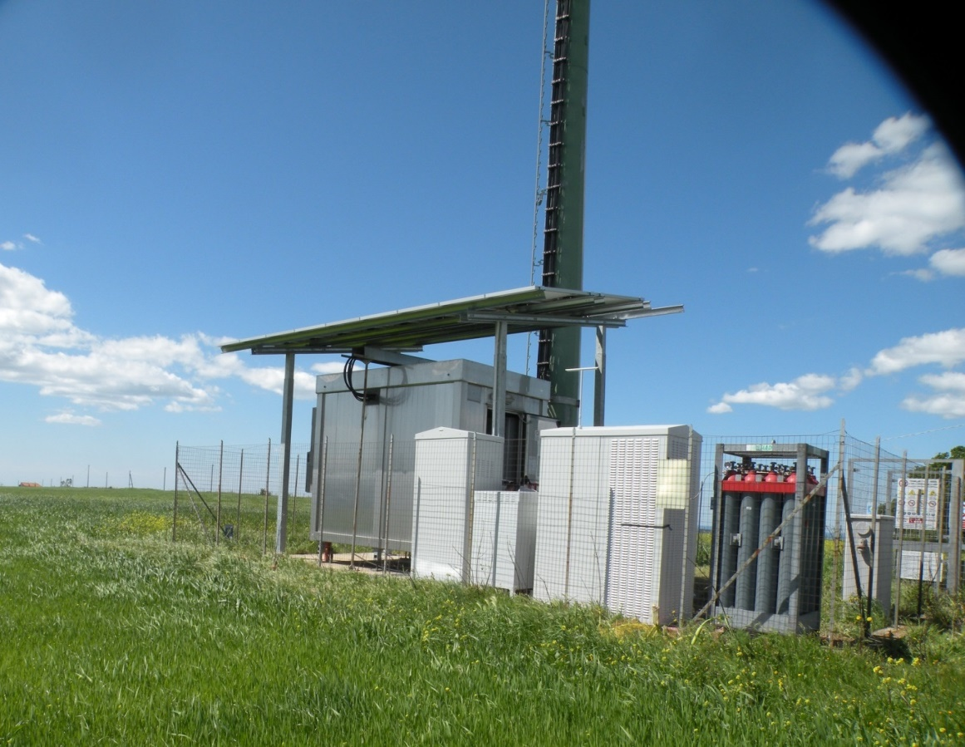
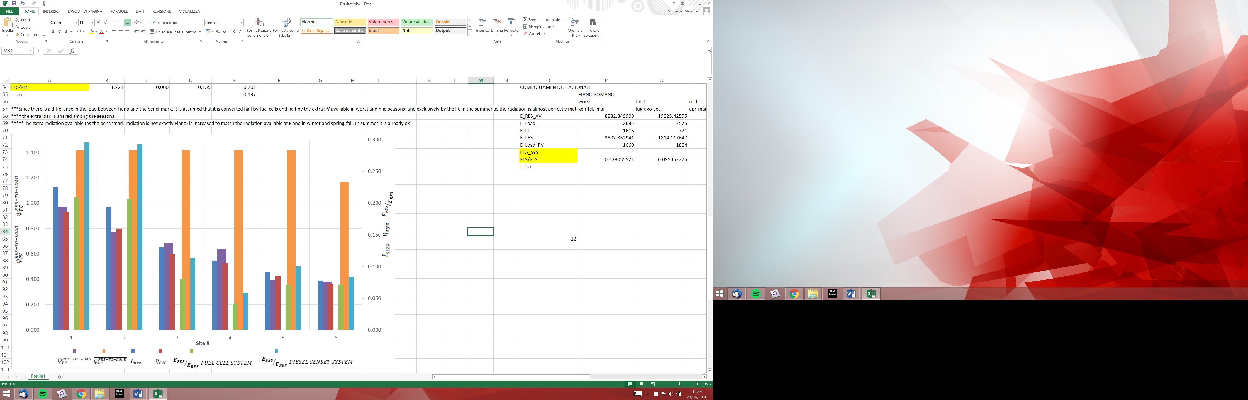
Measurements of power plots over time on the field for 6 HRES out of the total 13, over the year
Annual testing of 13 Hybrid Renewable Energy Systems (HRES) on the field for off-grid telecom applications coupled to real Radio Base Stations (RBS) in service
Calculation of synthetic performance parameters describing the performance of the 6 HRES over the year

