Slide 1
: iPSC-CM were treated up to 4 weeks with T3 (3nm and 30nm). Gene expression of TH target genes and/or are key markers of cardiac maturation were assessed by qPCR. For alpha/beta MHC, Beta1 ADR and SERCA, 3 batches of cells are tested. Each batch include triplicates. For NCX, RYR2, Beta2 ADR 1 batch of cells was tested including triplicates,
*** : P<0,001

Slide 2
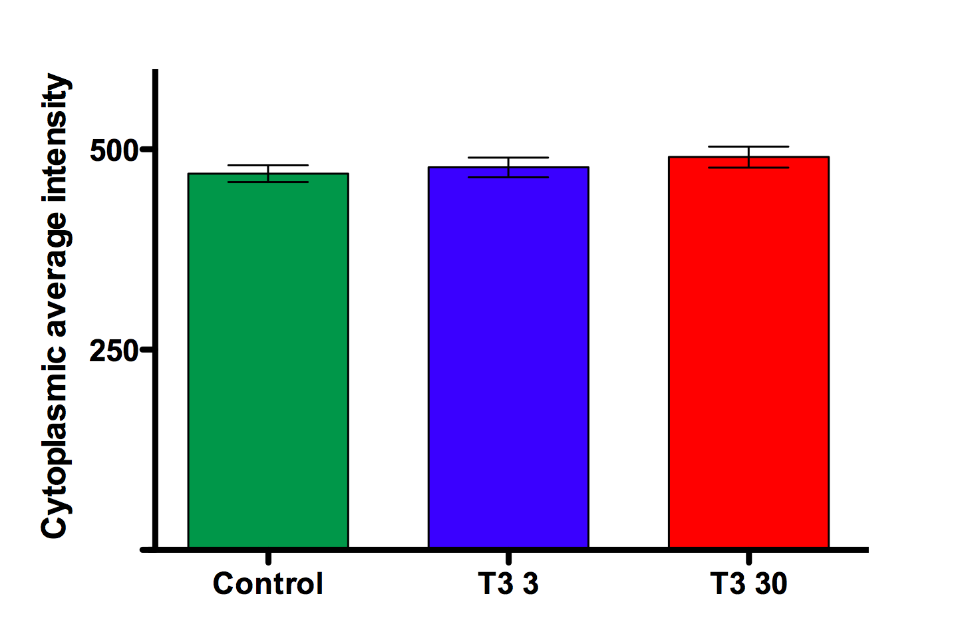
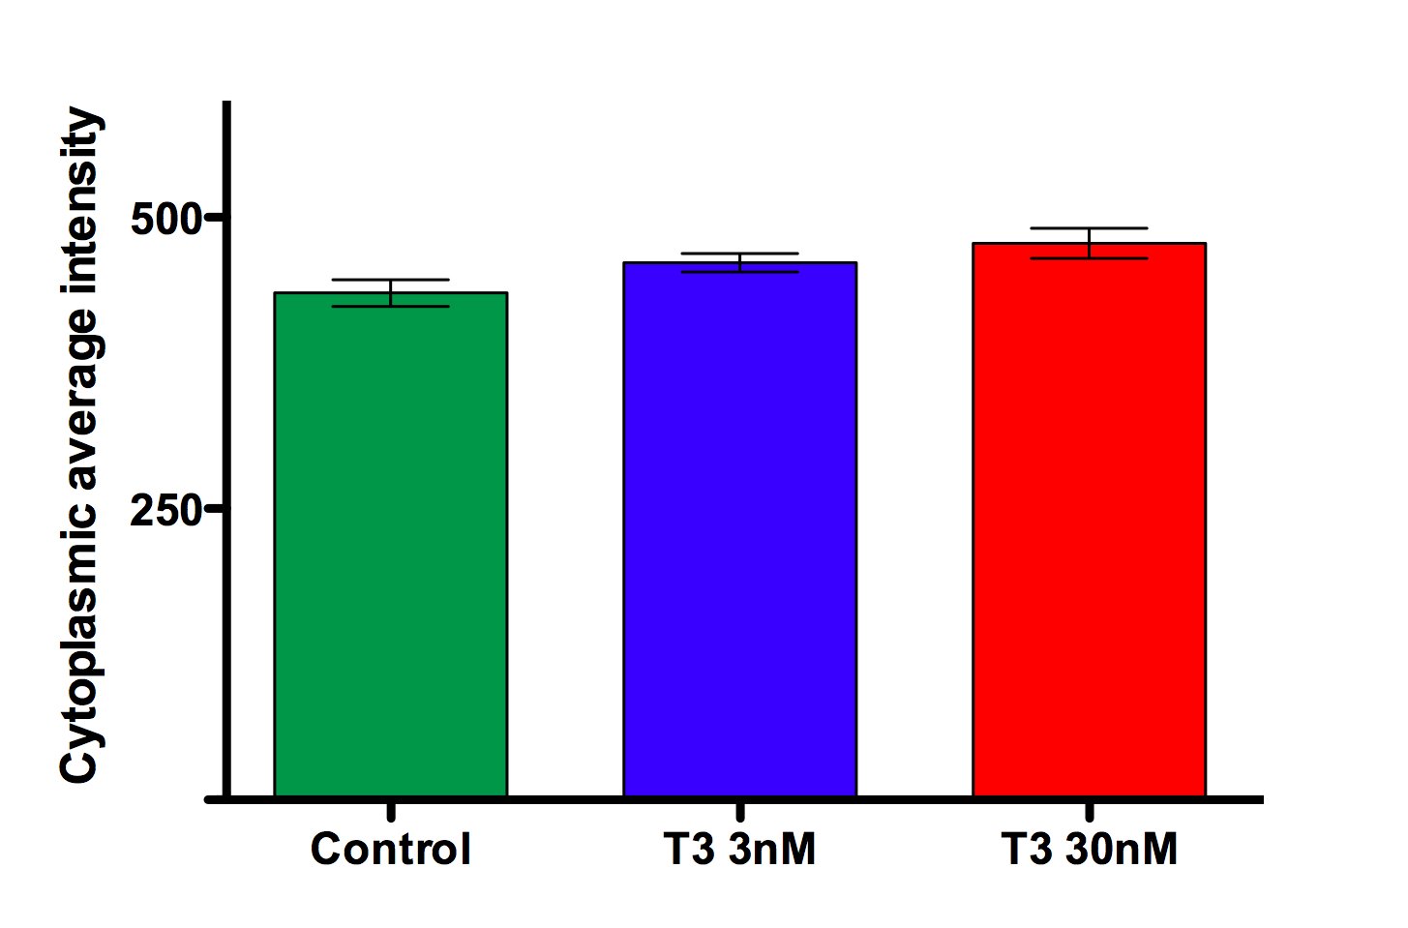
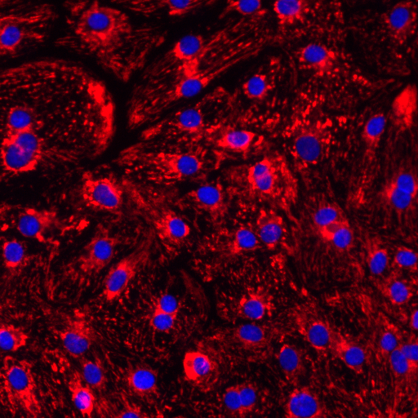
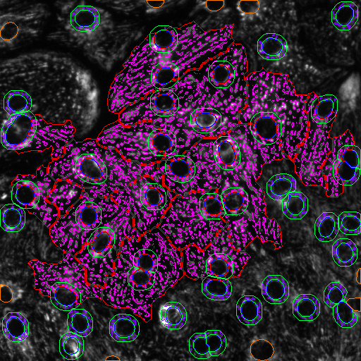
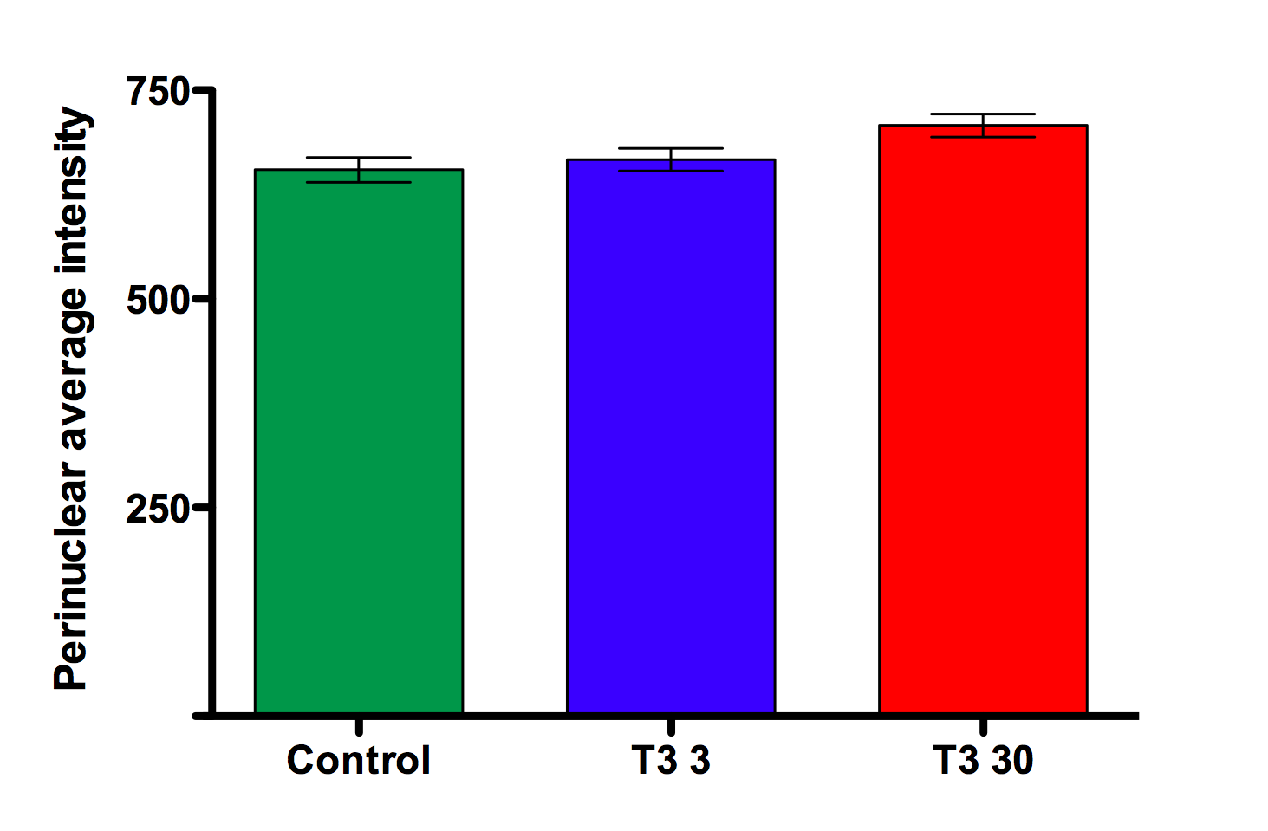
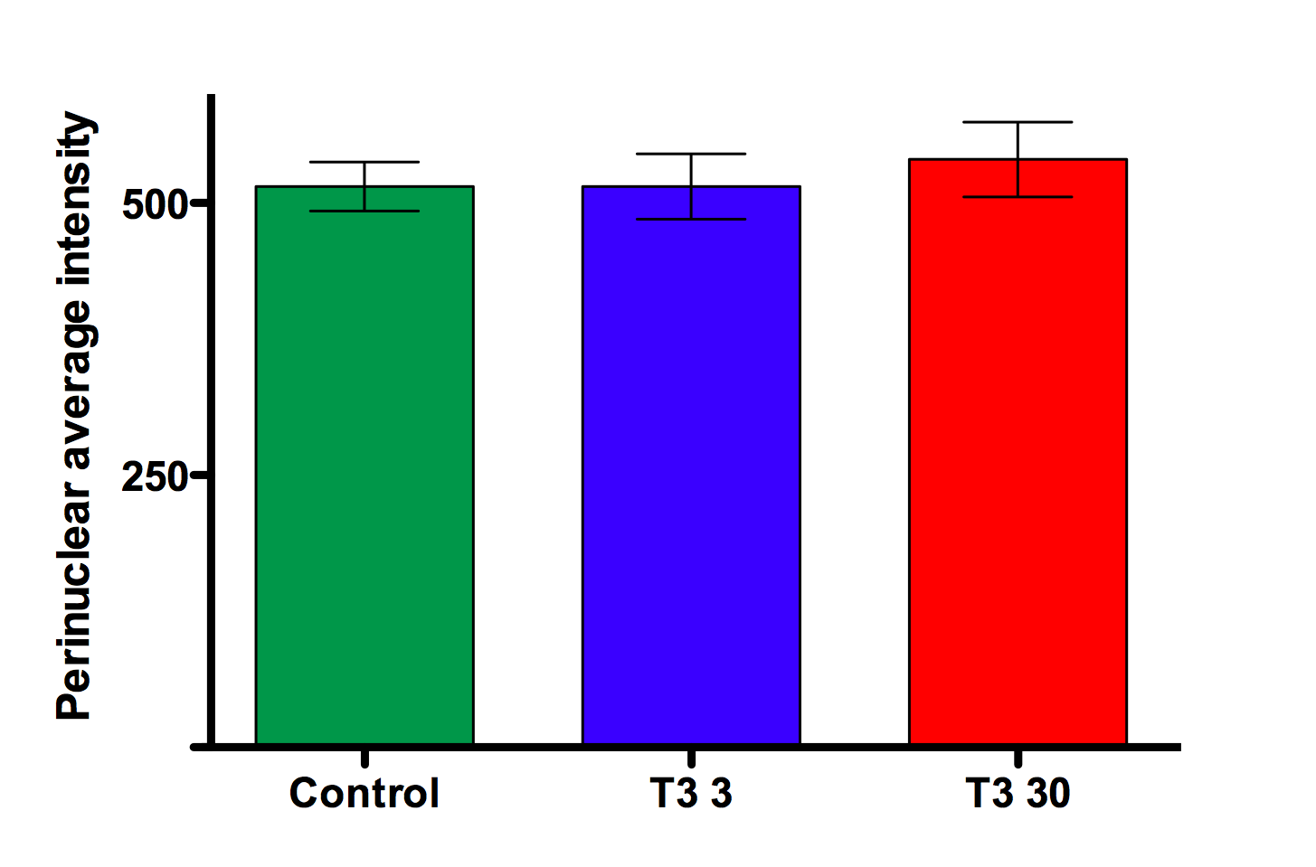
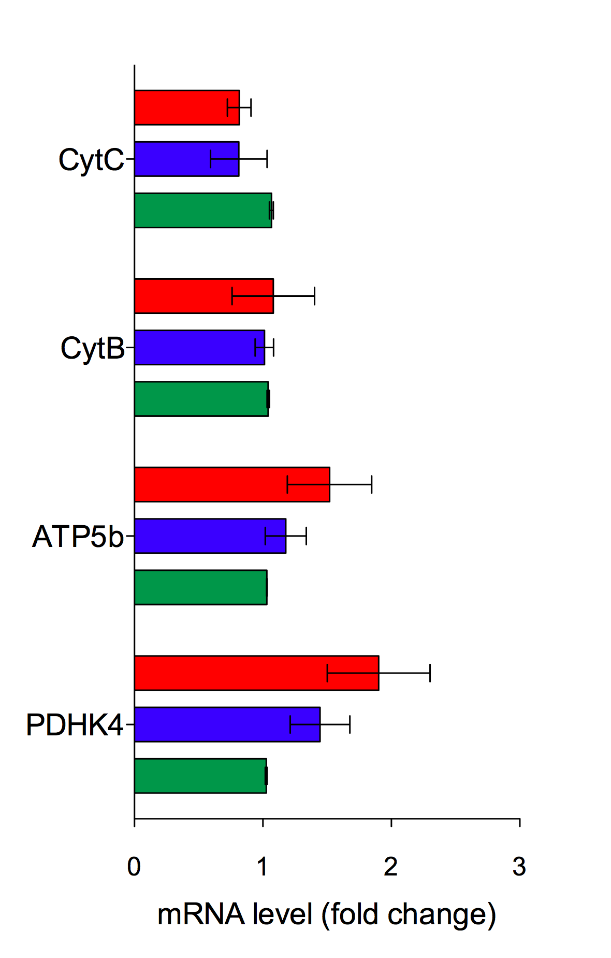
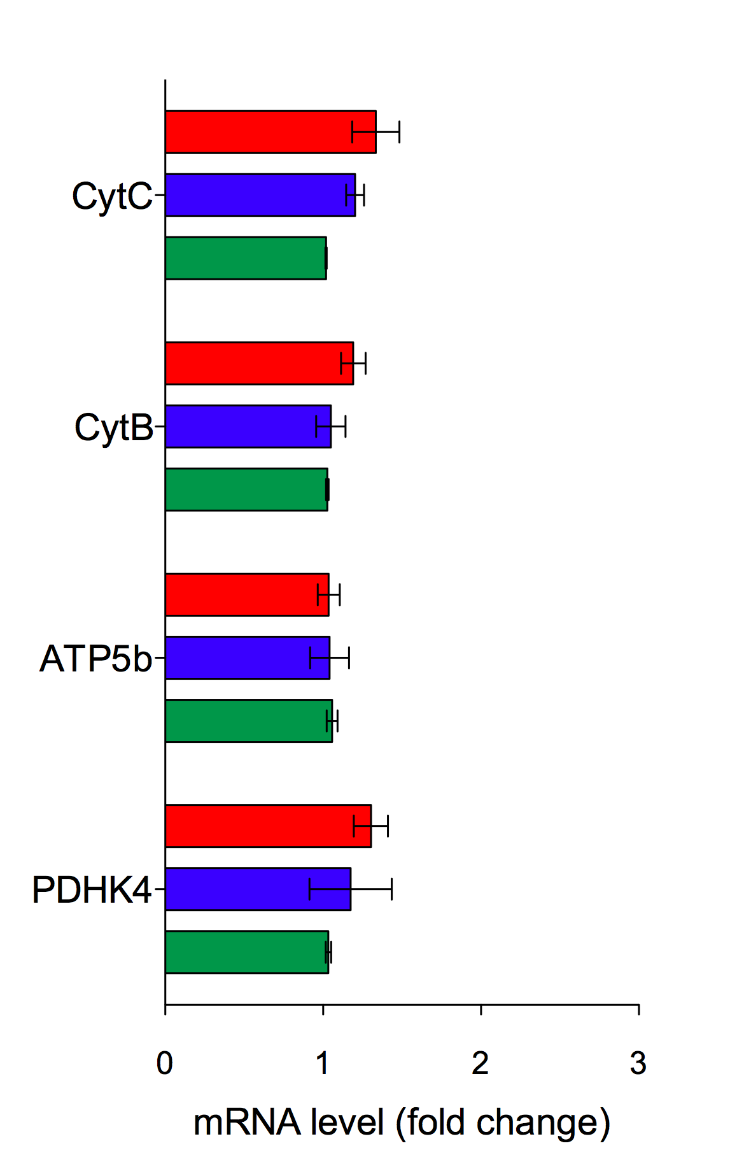
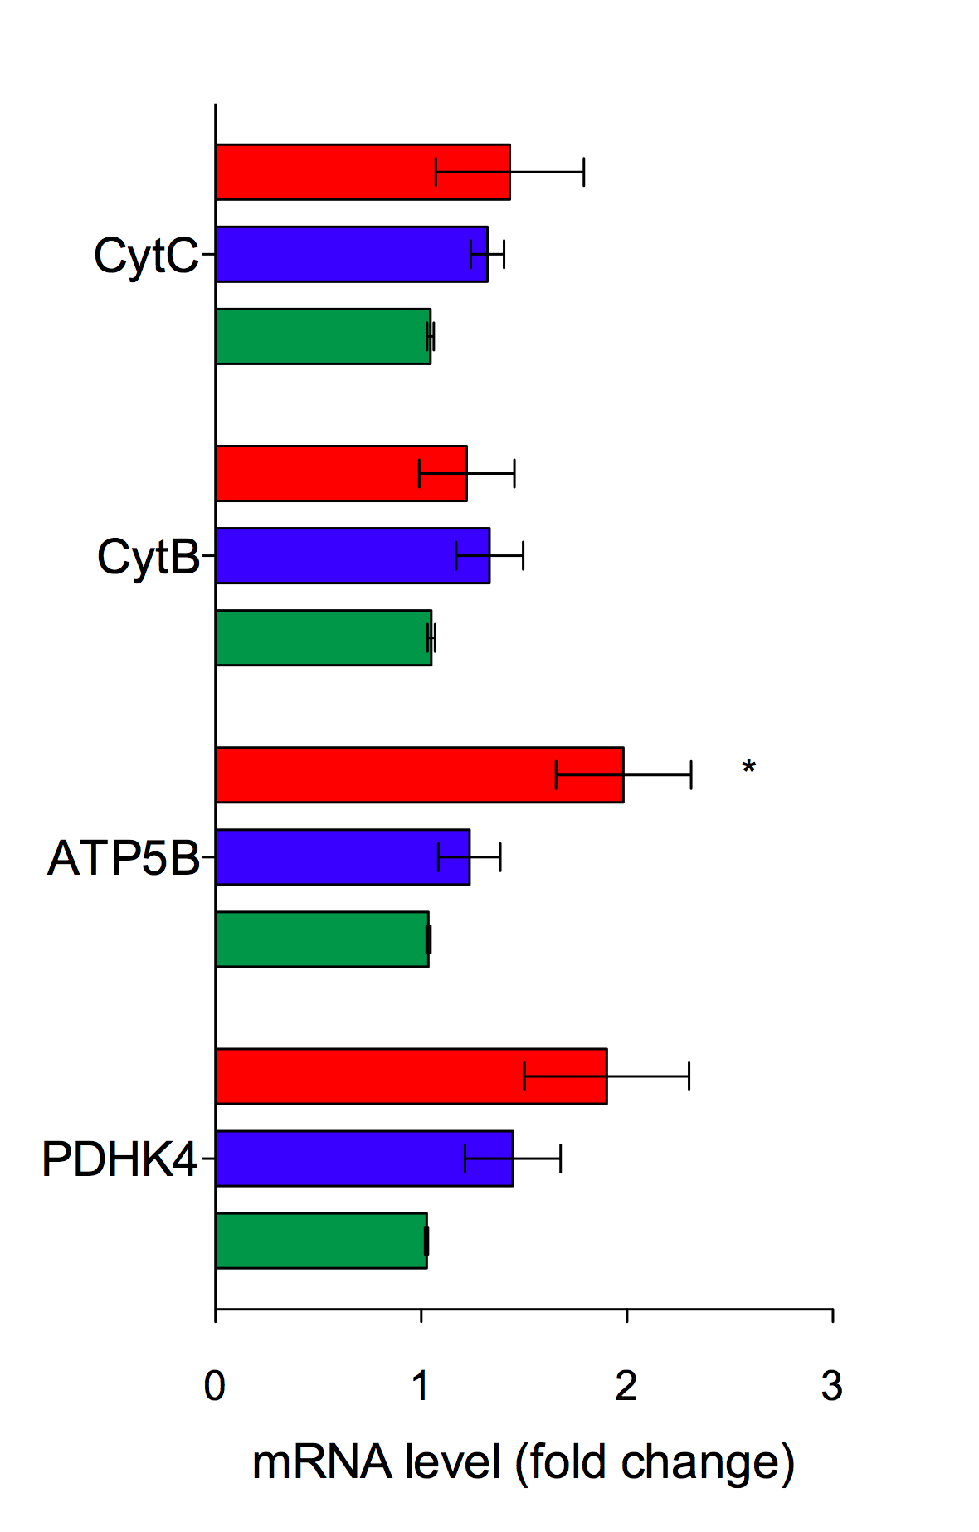
48h 2 weeks
48h 1week 2weeks
Figure 2: Energy metabolism and mitochondrial remodelling analysis. iPSC-CM were treated up to 2 weeks with T3 (3nm and 30nm). 3 batches of cells are tested. Each batch included triplicates. * = p<0.05.
. A) Representative images of IPSC-CM stained with TMRM (red) and Hoechst (blue) mitochondrial membrane potential and nucleus respectively. B) Plates were scanned on ArrayScan™ VTI automated microscopy and image analysis system (Cellomics). Bioassay quantified TMRM intensities and area in the cytoplasm and in the selected perinuclear region C) Gene expression of oxidative metabolism were assessed by qPCR.

Slide 3
Batch 1
*
*
*
Batch 2
*
*
*
*
***
***
A
Batch 1
Batch 2
B
C
Figure 3: Functional analysis. iPSC-CM were treated 2 weeks with T3 (3nm and 30nm). A) Direct visualization of intracellular Ca2+ in cardiomyocytes using Fluo-4 AM was used to study Ca2+ dynamics. Ca2+ transient data was acquired using live cell imaging with IPSC-CM spontaneously beating or under field stimulation. 2 batches of cells are tested. Each batch include triplicates. B) Beating rate calculation, n= 3 batches of cells. C) Beating rate was assed in response to CGP (an inverse agonist of the beta1 ADR - 10μM) 2 batches of cells are tested. Each batch include triplicates. . * = p<0.05; *** : P<0,001

Slide 4
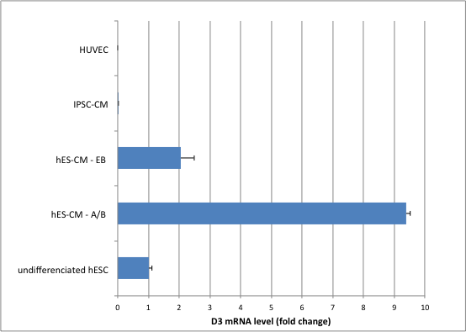
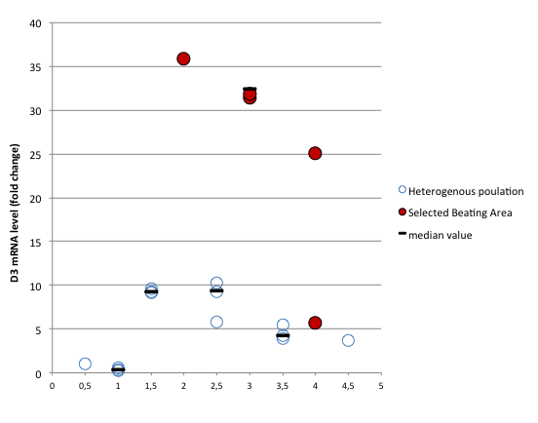
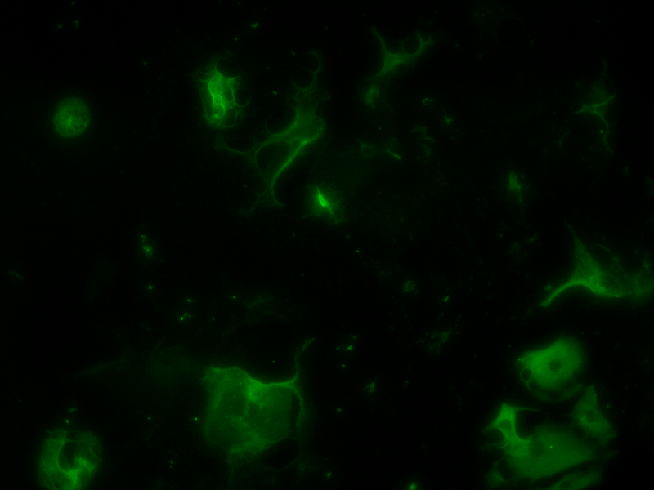
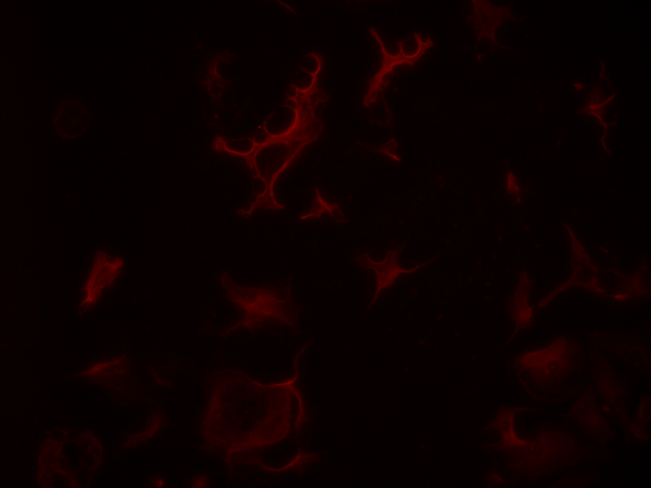
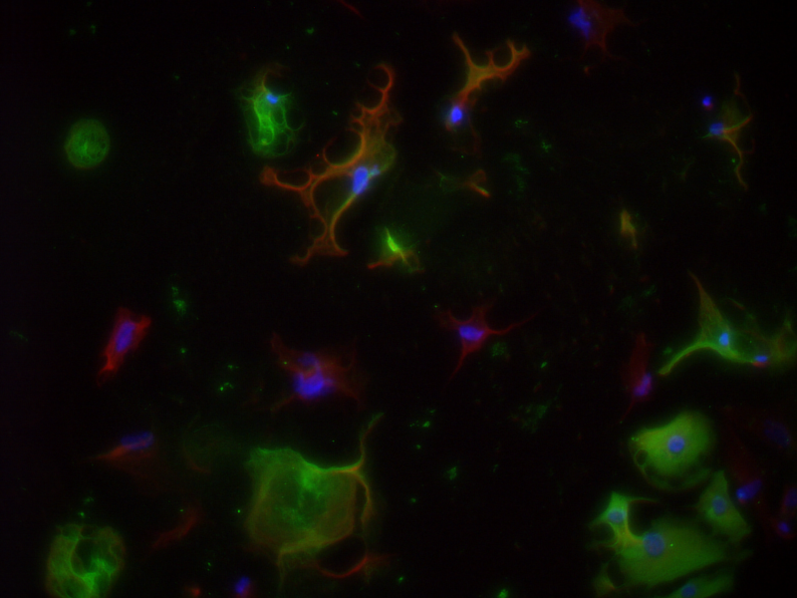
***
B
A
*
*
*
*
*
*
Troponin T
D3
Merge
C
Figure 4 : A) D3 expression in hSC-CM. Comparison of expression level of D3 in undifferentiated hESC versus iPSC-CM and hES-CM produced through EB or Activin/BMP4 techniques at one month of differentiation. HUVEC was used as negative control. B)Time course study of D3 expression level in hESC-CM produced through Activin/BMP4 techniques. Because cell populations obtained are not pure cardiomyocytes, the heterogeneous populations and the selected beating areas are compared; *** : P<0,001 C) hESC-CM-enriched culture stained with Troponin T (green), D3 (red) and Hoechst (blue). Arrow point out representative hES-CM positive for D3; stars point out representative hES-CM negative for D3
.

Slide 5
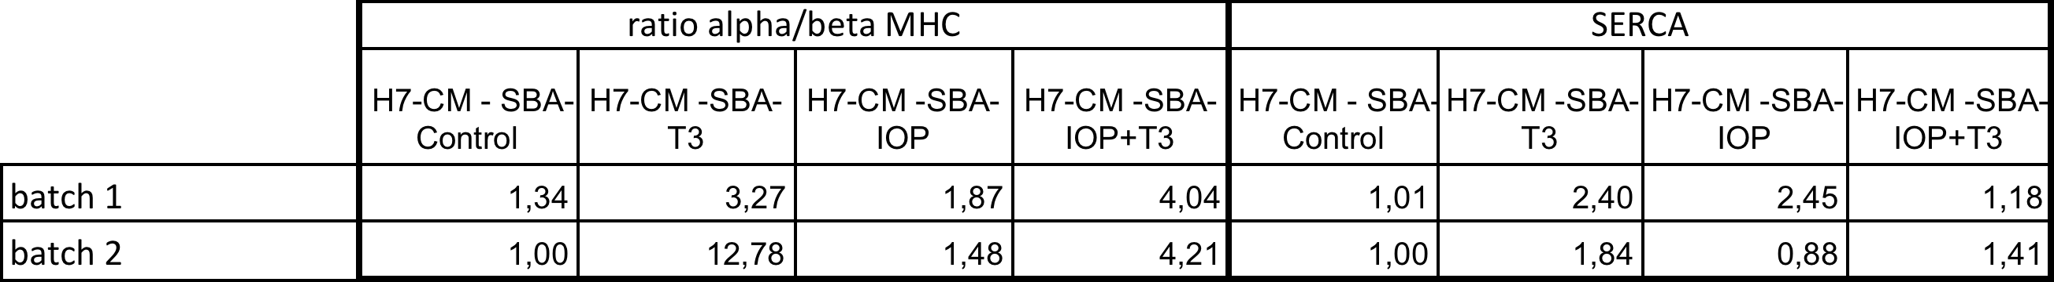
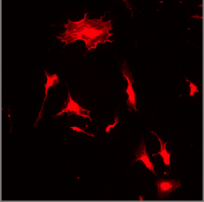
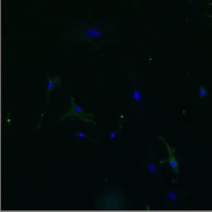
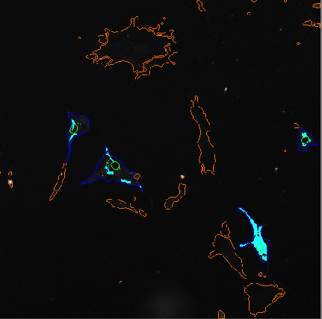
Batch 1
Batch 2
A
Trop T
DAPI
Bioanalysed
images
WCS
B
C
Figure 5: As an inhibitor of the D3, iopanoic acid (IOP) was used to block the enzyme activity and drive the cell maturation. hES-CM was treated with IOP and/or T3 (30nm). A) gene profile analysis. 2 batches of cells are tested. Each sample included 5 to 10 Selected Beating Area (SBA) B-C) Cell morphology and cell size were analysed with high content screening and high throughput screening (HCS/HT respectively) with automated fluorescent microscopy (Cellomics Arrayscan). B) Cells border was delimited by whole cell staining (red). hESC-CM-enriched culture stained with Troponin T (green). On Bioanalysed images showed positive cells for Troponin T in blue, rejected ones in orange. C) Treatments did not induced any modification on the of hES-CM size. Samples from batch 1 are tested – cells were plated and 3 wells of 96 well plates were analysed for each sample.

