Slide 1

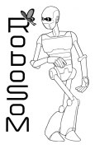




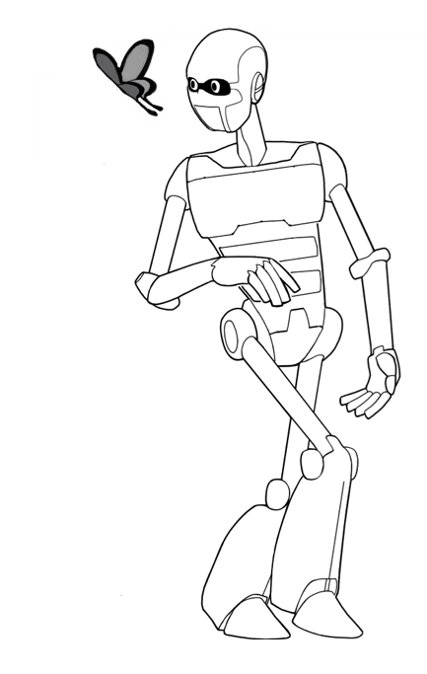





PARTNERSHIP
PROJECT INFORMATION
Project Coordinator:
Prof. Paolo Dario
Scuola Superiore Sant'Anna, Pisa, Italy
Scuola Superiore Sant’Anna (SSSA)
Piazza Martiri della Libertà, 33 – Pisa (Italy)
Tel: +39-050883420 Fax: +39-050883497
e-mail: paolo.dario@sssup.it
Scuola Superiore Sant’ Anna, Pisa (Italy)
Paolo Dario
paolo.dario@sssup.it
A ROBOTIC SENSE OF MOVEMENT
Centre National de la Recherche Scientifique, Paris (France)
Alain Berthoz alain.berthoz@college-de-france.fr
Contract number: FP7-248366
Start date: December 1, 2009
Project duration: 36 months
Activities codes: ICT-2009.2.1 Challenge 2: “Cognitive Systems, Interaction and Robotics”
Project cost: 2.163.237 €
EC contribution: 1.659.000 €
Istituto Superior Técnico, Lisbon (Portugal)
José Santos-Victor
jasv@isr.ist.utl.pt
The RoboSoM project involves four partners from: Italy, France, Portugal, Japan
Waseda University, Tokyo (Japan)
Atsuo Takanishi
takanisi@waseda.jp
www.robosom.eu
www.robosom.eu
www.robosom.eu

Slide 2
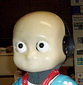
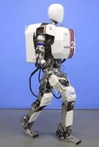
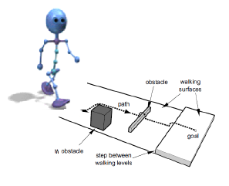
OBJECTIVES
THE SENSE OF MOVEMENT
The scientific objective is to validate the new and extended model of whole-body coordination in human walking.
The methodology of the human experiments used to capture locomotor path and gaze movements will require VICON motion system and eye tracker system.
Exchanges between neuroscience and robotics are the key point of the human model integration to the RoboSoM system.
RoboSoM aims at the study and robotic implementation of a model of the sense of movement, that endows a humanoid robot with advanced perception and action capabilities in biped locomotion, based on a unified inertial reference frame and on predictive behavior.
This implementation in a very advanced humanoid robot will lead to enhanced performance in the real world, in terms of capability of accomplishing practical and helpful tasks.
Two main ideas relate to the concept of sense of movement:
the integration of a variety of sensory signals, mostly proprioceptive: the brain uses this information to generate a unified inertial reference frame, centred in the head, that allows whole-body coordinated movements and head-oriented locomotion;
in humans, perception is not just the interpretation of sensory signals, but a prediction of consequences of actions. Perception can be defined as a simulated action: perceptual activity is not confined to the interpretation of sensory information but it anticipates the consequences of action (Expected Perception).
EXPECTED RESULTS
The final objective of the RoboSoM project is the integration of the visual apparatus in the robotic biped platform, able to execute head stabilization during locomotion, and the implementation of the human-gaze guided locomotion model.
MODELS OF GAZE-GUIDED LOCOMOTION TRAJECTORIES
The robot will be able to:
straight walk to
reach a visual
target, also with
obstacles
avoidance
follow a moving
target
free walk in
different and
unknowing environment.
Neuroscientists and mathematicians design the experiments to perform on human locomotion, based on the current relevant advances and the knowledge needed in Robotics and Neuroscience research.
www.robosom.eu
www.robosom.eu
www.robosom.eu

